Slide 1

OLA BIKE RIDE REQUEST FORECAST
OLA BIKE RIDE REQUEST FORECAST
By Aaryan Parganiha 22CSU005
DS-A

Slide 2
Introduction
Background
From telling rickshaw-wala where to go, to tell him where to come we have come a long way. Yes, I am talking about online cab and bike facility providers like OLA and Uber. If you have used this app then sometimes you must have paid some day less and someday more for the same journey. But have you ever thought what is the reason behind it? It is because of the high demand at some hours. this is not the only factor but this is one of them.
Objective
The objective of this project is to develop a machine learning model to predict ride-request for a particular hour using machine learning.

Slide 3
Dataset Description
I have picked this dataset from Kaggle(ola.csv)
Dimension of my dataset would is (10886,61) 10886 rows and 61 columns
Data types-int and float
Key features
Humidity
Temperature
Avg Temprature
Windspeed
Weather
Casual/Registered user etc

Slide 4
MACHINE LEARNING MODEL
Model Selection:
I have applied Linear regression ,Decision Tree Regressor, K-nn Regressor , Random Forest Regressor , XGB Regressor ,Lasso Regressor ,Ridge Regressor and Elastic-net Regressor to predict ride request
Why use these models?
Random Forest models can identify and model complicated relationships between input variables and the output variables that are not straightforward or linear
XGBoost builds models in a sequential manner, where each new model corrects the errors made by the previous ones. This helps improve predictive accuracy over multiple iterations

Slide 5
Linear Regression is one of the most commonly used machine learning algorithms. It is used for predicting a continuous dependent variable based on one or more independent variables. The model assumes a linear relationship between the input variables (independent variables) and the output variable (dependent variable).
Decision Tree Regression is a popular machine learning algorithm used for predicting continuous outcomes. It works by recursively splitting the dataset into subsets based on feature values, aiming to minimize the variance within each subset
K-Nearest Neighbors (KNN) Regression is a simple yet powerful algorithm used to predict a continuous target variable by averaging the values of the kkk nearest neighbors in the feature space.

Slide 6
Lasso Regression (Least Absolute Shrinkage and Selection Operator) is a type of linear regression that includes an L1​ regularization term in its cost function. This regularization encourages sparsity, effectively shrinking some feature coefficients to zero, which simplifies the model by performing automatic feature selection.
Ridge Regression is a type of linear regression that includes an L2 regularization term in its cost function. It is specifically designed to handle multicollinearity and prevent overfitting in datasets where features are highly correlated or when the number of predictors is large.
Elastic Net Regression combines the strengths of both Lasso and Ridge regression. It uses a mix of L1 (Lasso) and L2(Ridge) regularization to provide better performance when features are correlated or when there are many predictors. This hybrid approach offers flexibility by balancing feature selection and coefficient shrinkage.

Slide 7
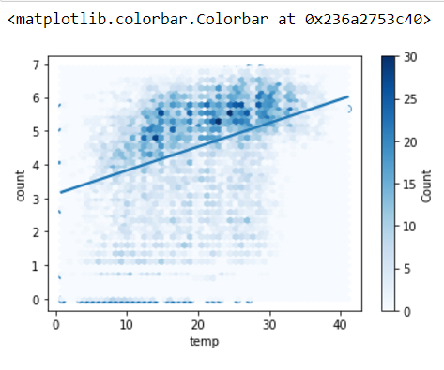
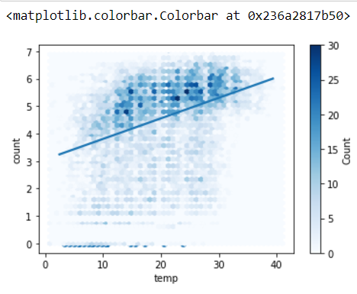
Linear regression-Regression Plot for training and test data
Training set
Test Set

Slide 8
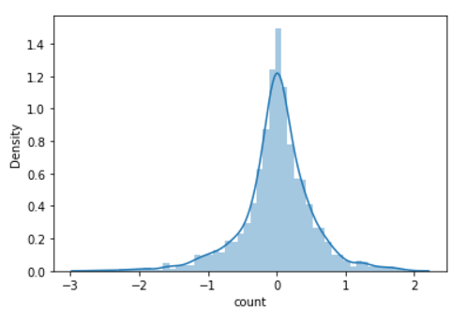

Result
R2-0.8761
Mean squared error-0.2655

Slide 9
Decision Tree
A decision tree is a flowchart-like structure used to make decisions or predictions.
Structure of a Decision Tree
Root Node: Represents the entire dataset and the initial decision to be made.
Internal Nodes: Represent decisions or tests on attributes. Each internal node has one or more branches.
Branches: Represent the outcome of a decision or test, leading to another node.
Leaf Nodes: Represent the final decision or prediction. No further splits occur at these nodes

Slide 10
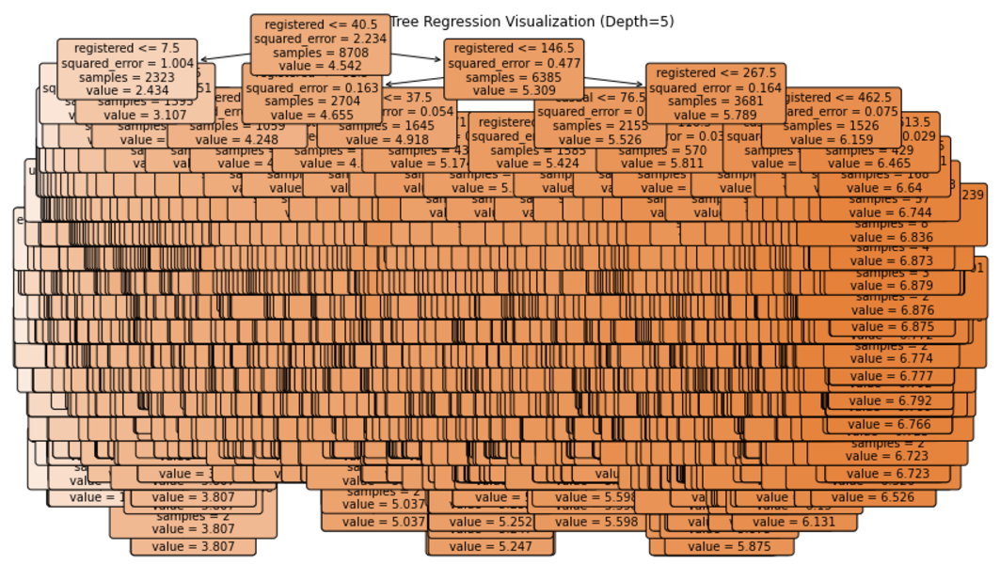
Tree Regression Visualization

Slide 11
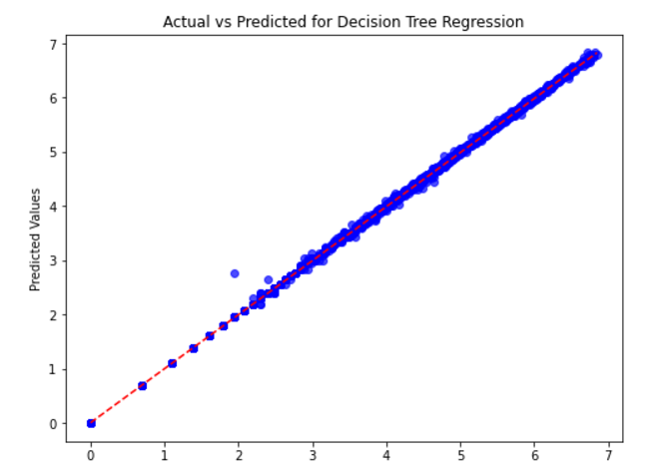
Actual vs Predicted Values

Slide 12
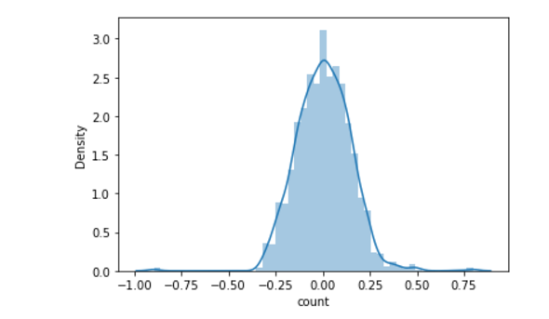
Result
R2-0.990218
MSE-0.1127
MAE-0.0209

Slide 13
Hyperparameter Tuning(Hypertuning)
Hyperparameter Tuning is the process of finding the best set of hyperparameters for a machine learning model to improve its performance. Hyperparameters are the settings or configuration values that are set before training a model, and they can significantly impact the model's accuracy, efficiency, and generalization ability.
Used Hyper Parameters in KNN, Random forest and XGBoosting

Slide 14
Hypertuned KNN Regression
KNN regression, the model predicts the value of a target variable based on the average (or weighted average) of the target variable values of the K nearest data points in the feature space.
Parameters that are hypertuned
1)n-Neighbours:
2)n-jobs:

Slide 15
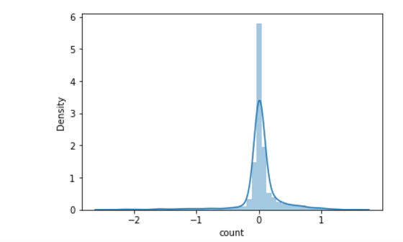
Result
R2-0.9455
MSE-0.11688
MAE-0.1641

Slide 16
Hypertuned Random Forest
Random Forest is a powerful ensemble learning algorithm used for both classification and regression tasks. It builds multiple decision trees and merges their results to produce more accurate and stable predictions. Each tree in the forest is trained on a random subset of the data and only a random subset of features, helping to reduce overfitting and improving the model's generalization.

Slide 17
Hypertuned Parameters
n_estimators:This defines the number of trees in the random forest. Here, it's set to [500], meaning GridSearchCV will try only one value for the number of trees: 500.
n_jobs:This specifies how many CPUs to use during model fitting. Setting n_jobs=-1: tells the algorithm to use all available cores, which speeds up the training process (especially when working with large datasets).
max_features: This defines the maximum number of features to consider when splitting a node. The values provided are
:"auto": This will use all features (default behavior).
"sqrt": This will use the square root of the total number of features.
"log2": This will use the base-2 logarithm of the number of features.

Slide 18
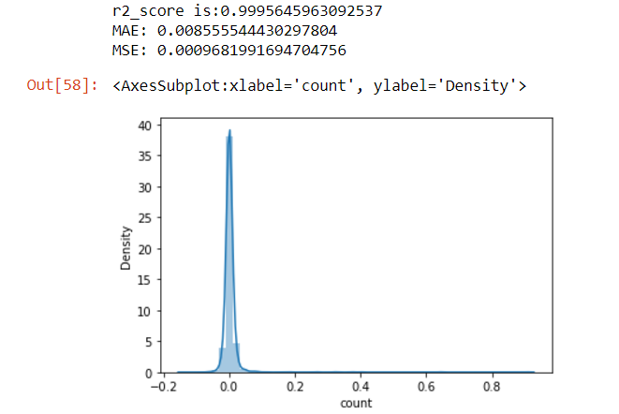
Result

Slide 19
Hypertuned XGBoosting
Extreme Gradient Boosting is an ensemble learning technique where models are built sequentially. Each subsequent model tries to correct the errors made by the previous models. In the context of XGBoost, the base models are decision trees. The boosting process works by fitting a new tree on the residuals (errors) of the previous trees.

Slide 20
Hypertuned Parameters
learning_rate: Controls how much each tree corrects the errors of the previous one. A lower value requires more trees to fit the model but prevents overfitting.
max_depth: The maximum depth of the trees. A higher value allows for more complex trees, but this can also lead to overfitting.
min_child_weight: Minimum sum of instance weight (hessian) in a child. It helps prevent overfitting by controlling the complexity of each tree.
subsample: Proportion of training data to randomly sample for each tree. Lower values can help prevent overfitting.
colsample_bytree: The fraction of features to choose when building each tree. Helps reduce overfitting.
n_estimators: The number of boosting rounds (trees) to build.

Slide 21
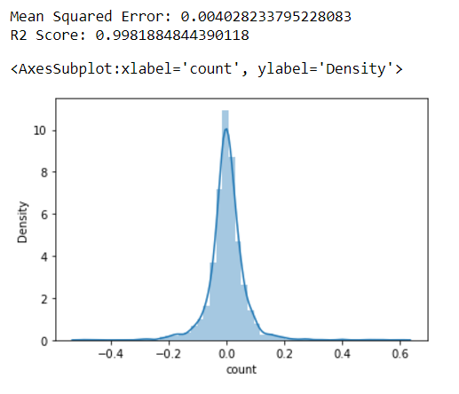
Result

Slide 22
Ridge Regression
Ridge Regression modifies the linear regression model by adding a penalty term (L2 regularization) to the cost function to shrink the coefficients of less important features, effectively reducing model complexity and mitigating overfitting.

Slide 23
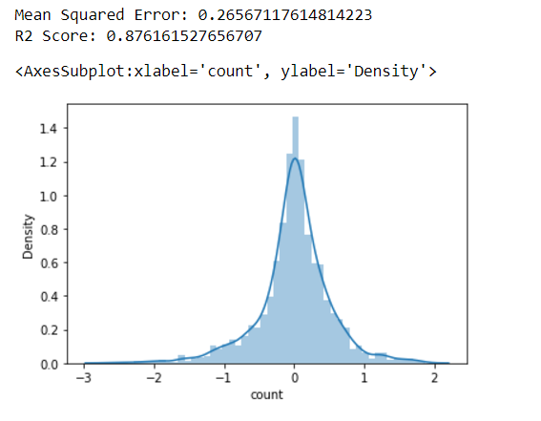
Result

Slide 24
Lasso Regression
Lasso Regression is another variant of Linear Regression that incorporates L1 regularization to address issues related to overfitting, especially when there are many features or when some features are not useful for predicting the target variable.Lasso stands for Least Absolute Shrinkage and Selection Operator, and it has the ability to shrink the coefficients of less important features to exactly zero, effectively performing feature selection

Slide 25
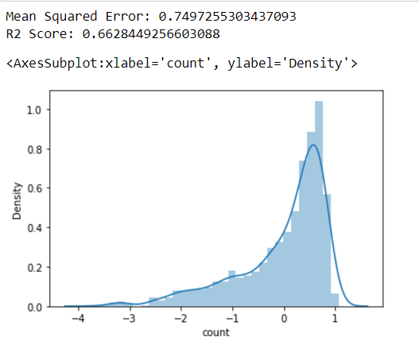
Result

Slide 26
Elastic Net Regresion
Elastic Net Regression is a regularized regression model that combines both L1 (Lasso) and L2 (Ridge) regularization techniques. It is particularly useful when you have many correlated features in your dataset and when you want to improve model performance by preventing overfitting.

Slide 27
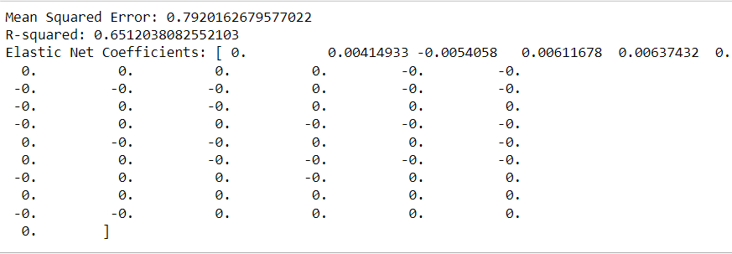
Result

Slide 28
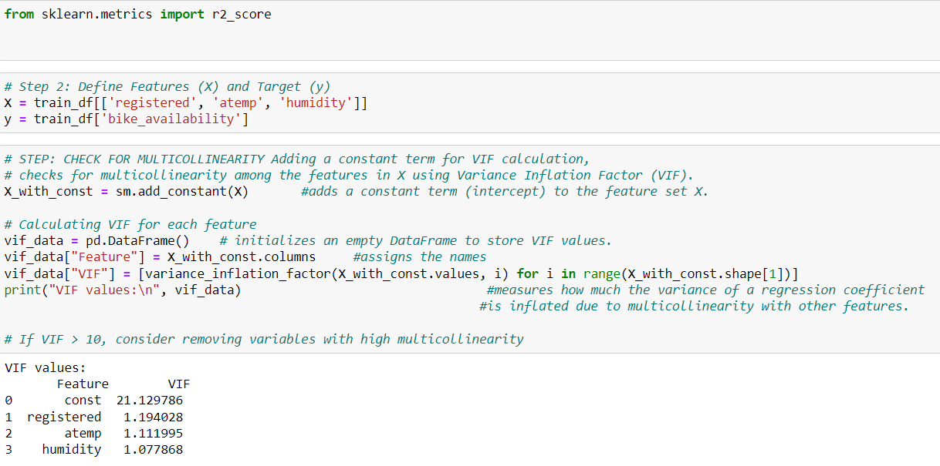
Why I didn’t use MLR(or any regression technique that is affected by multicollinearity)

Slide 29
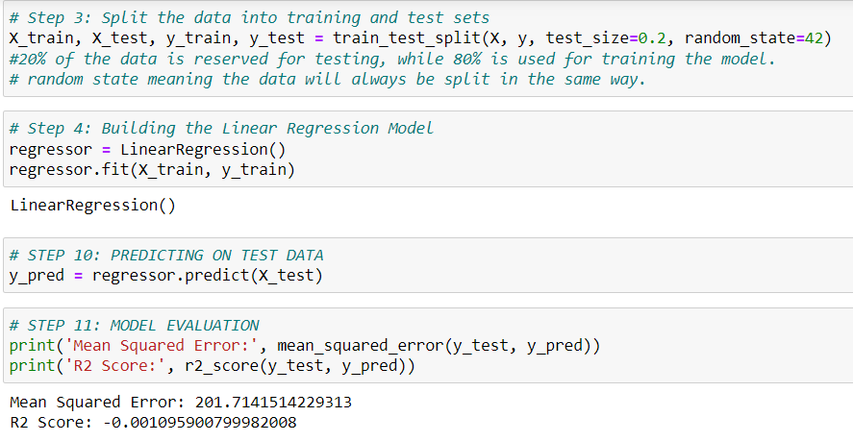

Slide 30
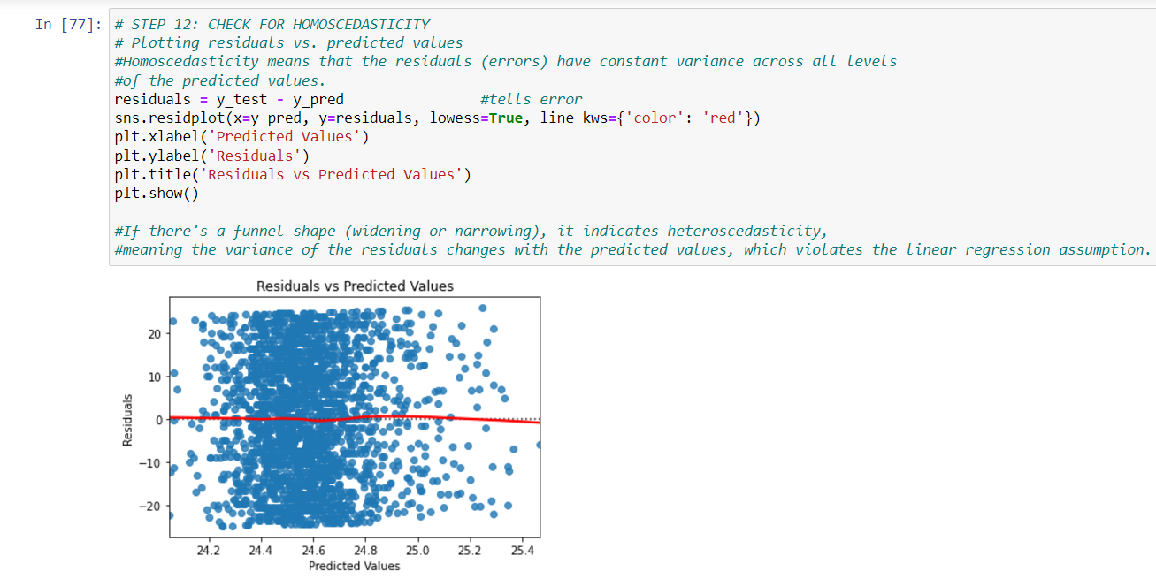

Slide 31
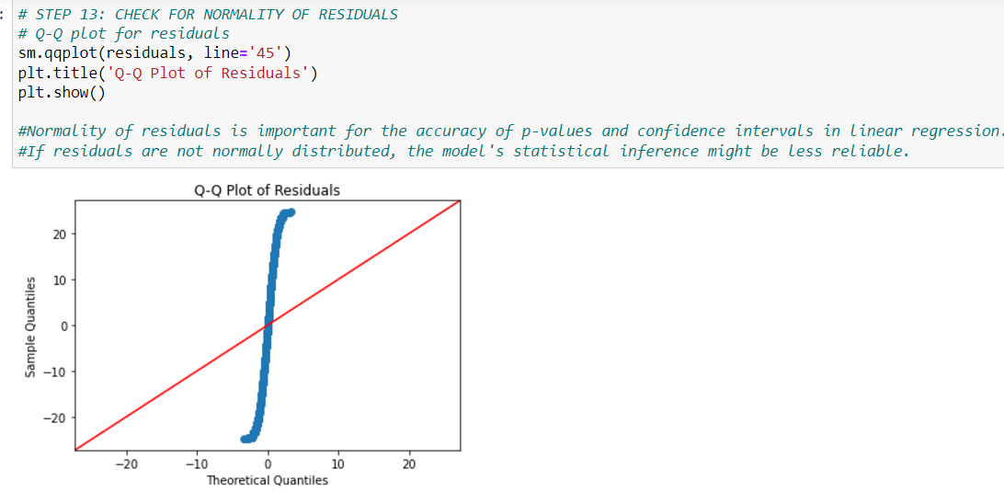

Slide 32
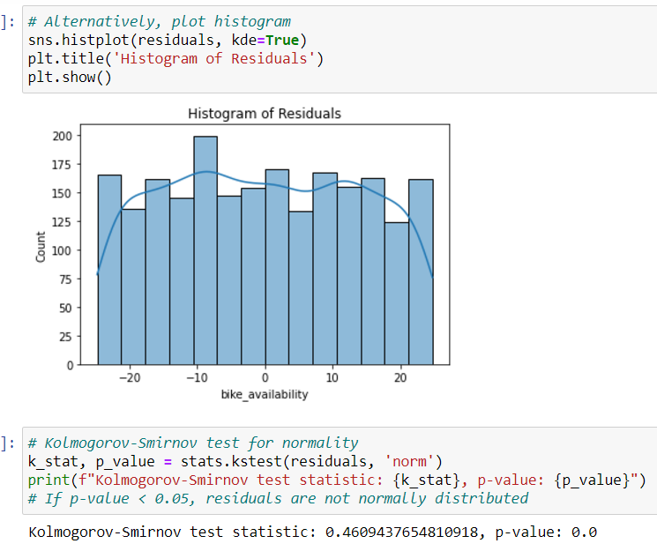

Slide 33
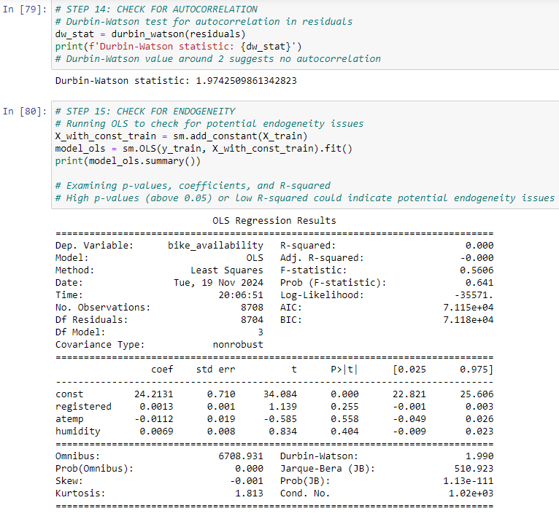

Slide 34
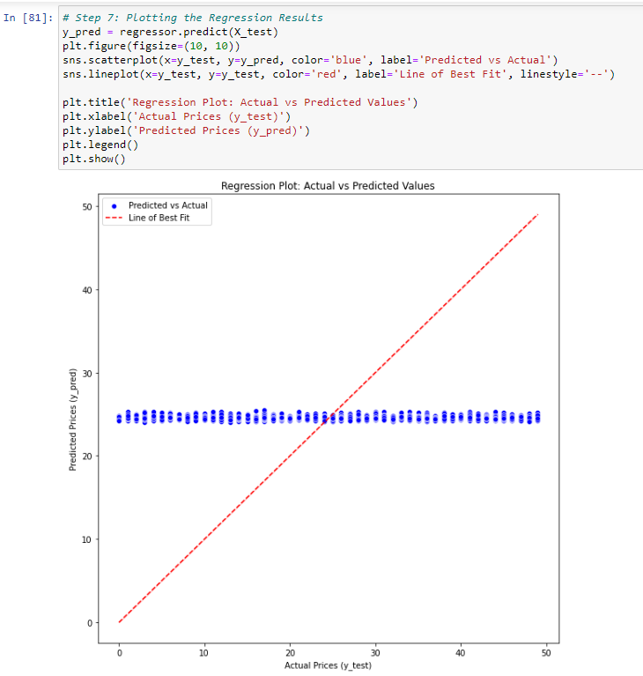

Slide 35
Conclusion
Best Regression Model for this dataset- Hypertuned RandomForest Regression with an accuracy of 99.95%
Worst Regression Model for this dataset- MLR with an accuracy of 0.010%

Slide 36
THANK YOU

